Slide 1
CHM 5175: Part 2.4
Other Absorption Techniques
Source
Detector
hν
Sample
Ken Hanson
MWF 9:00 – 9:50 am
Office Hours MWF 10:00-11:00

Slide 2
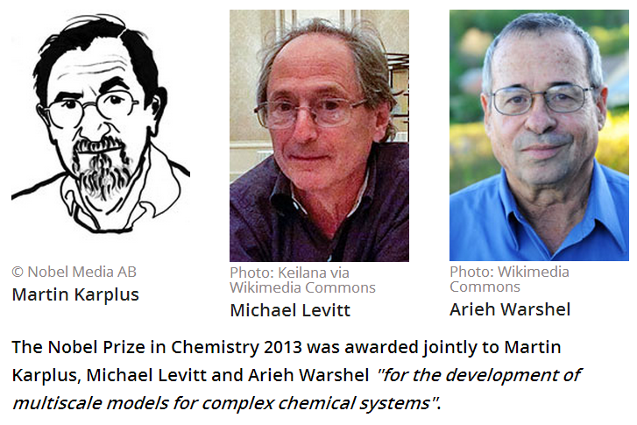
2013 Nobel Prize in Chemistry

Slide 3
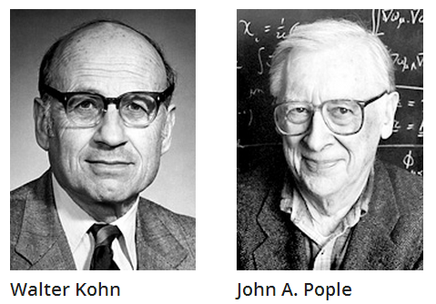
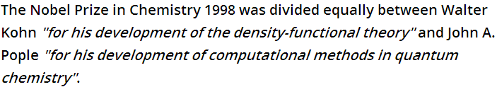
1998 Nobel Prize in Chemistry

Slide 4
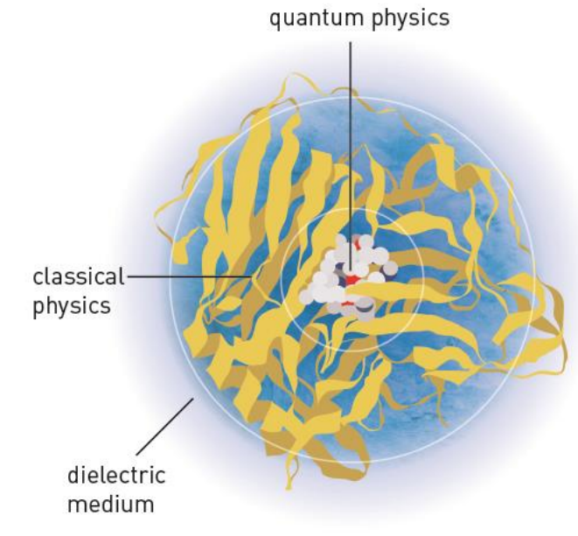
2013 Nobel Prize in Chemistry
DEVELOPMENT OF MULTISCALE MODELS FOR COMPLEX CHEMICAL SYSTEMS

Slide 5
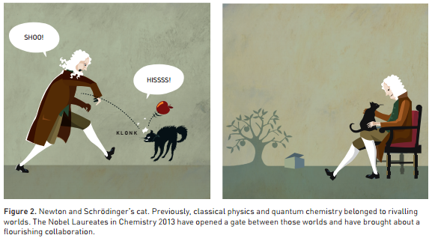
2013 Nobel Prize in Chemistry
DEVELOPMENT OF MULTISCALE MODELS FOR COMPLEX CHEMICAL SYSTEMS

Slide 6
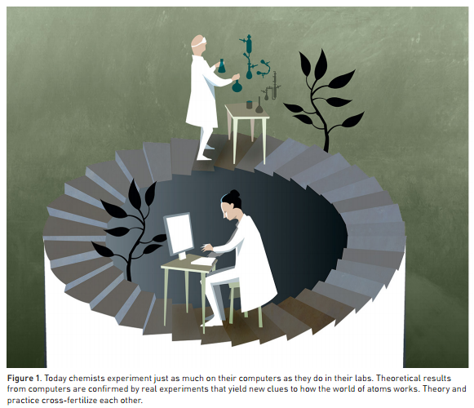
2013 Nobel Prize in Chemistry
DEVELOPMENT OF MULTISCALE MODELS FOR COMPLEX CHEMICAL SYSTEMS

Slide 7

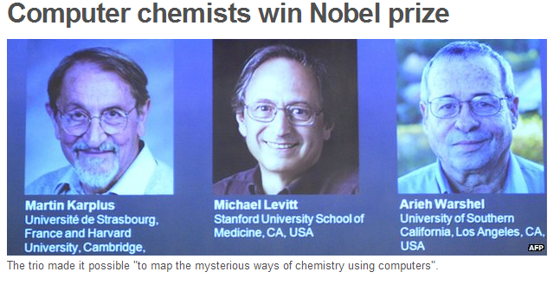

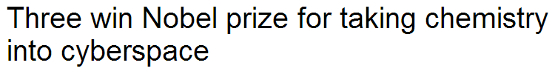

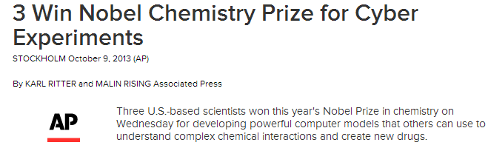
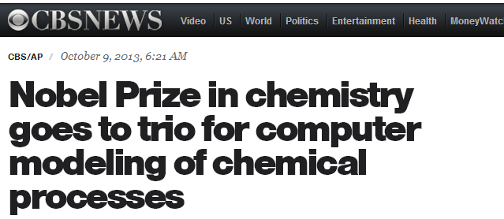
2013 Nobel Prize in Chemistry

Slide 8
CHM 5175: Part 2.4
Other Absorption Techniques
Source
Detector
hν
Sample
Ken Hanson
MWF 9:00 – 9:50 am
Office Hours MWF 10:00-11:00

Slide 9
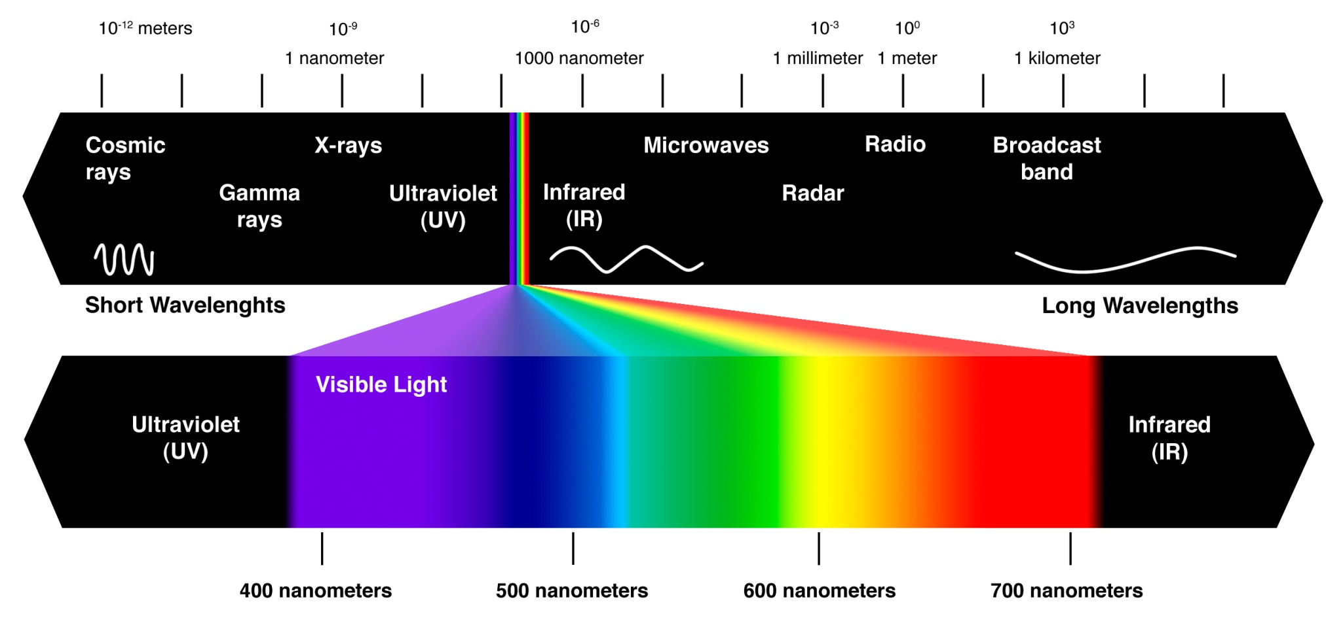
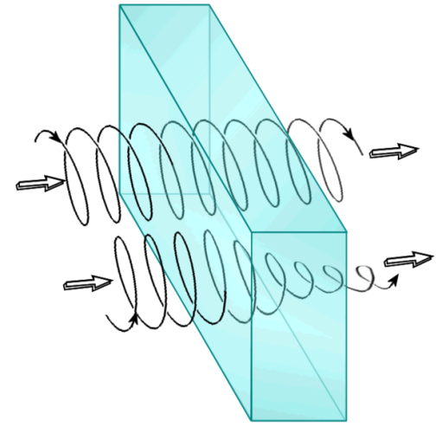
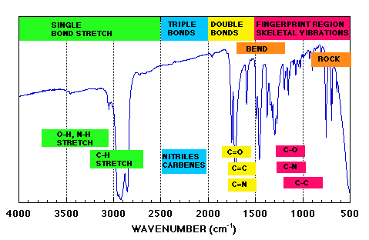
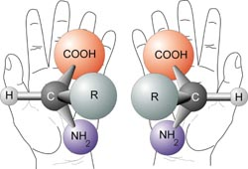
Content
Source
Detector
hν
Sample
1) Circular Dichroism
2) Infrared Spectroscopy

Slide 10
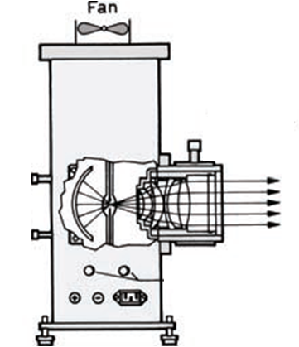
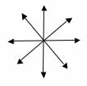
UV-Vis Spectroscopy
Detector
Sample
End View
Unpolarized Light

Slide 11
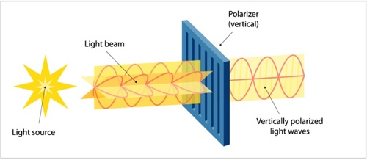
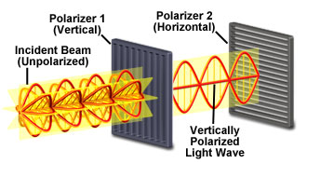
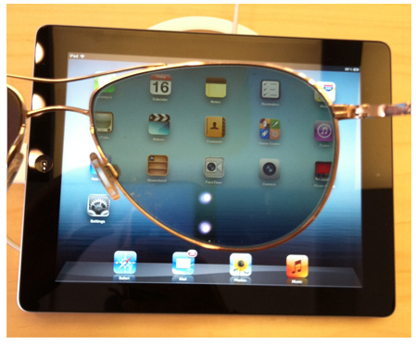
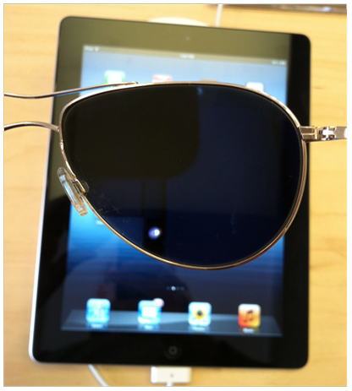
Polarizers

Slide 12
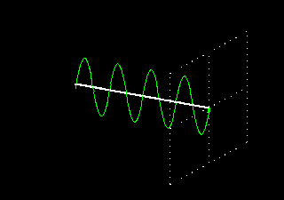
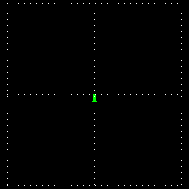
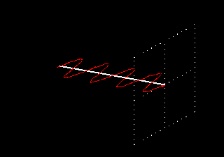
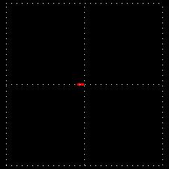
Polarization of Light
Vertically Polarized
Side View
End View
Horizontally Polarized
http://www.enzim.hu/~szia/cddemo/edemo0.htm

Slide 13
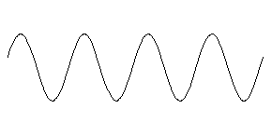
Light + Molecules
Source
Strong Absorption
Weak Absorption

Slide 14
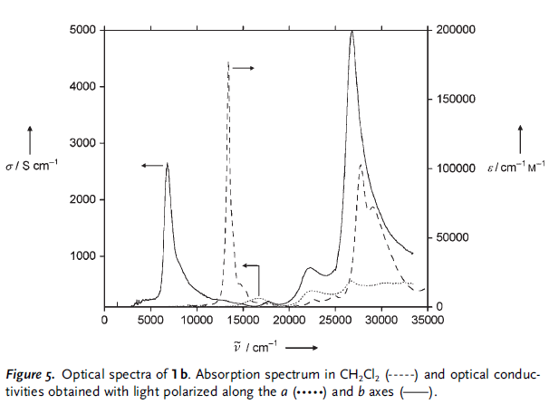
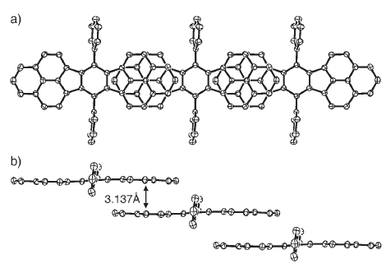
Orientation Dependent Absorption
a axis
b axis
Angew. Chem. Int. Ed. 2005, 44, 6564 –6568

Slide 15
Polarization of Light
Vertically Polarized
Side View
End View
Horizontally Polarized
http://www.enzim.hu/~szia/cddemo/edemo0.htm

Slide 16
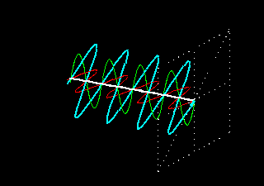
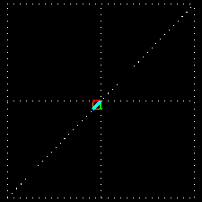
Adding Polarized Light
In phase (peak at the same time) + same amplitude
Vertical + Horizontal = 45° diagonal

Slide 17
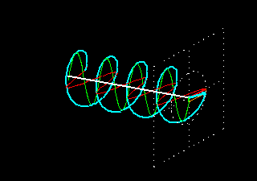
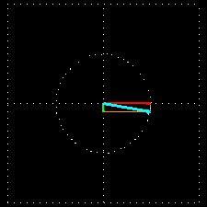
Adding Polarized Light
¼ λ (90°) out of phase + same amplitude
Vertical + Horizontal = Circular
Green peaks when red baselines.
Sum (blue) is always 1.

Slide 18
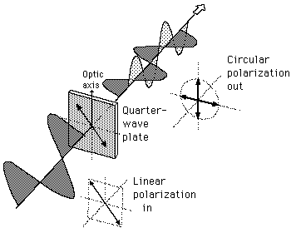
λ/4 Wave Plate Polarizer
λ/4 Wave Plate Polarizer

Slide 19
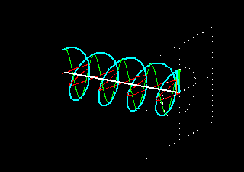
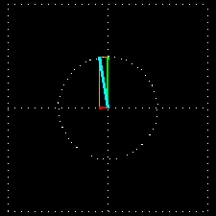
Polarization of Light
left-circularly polarized
Side View
End View
right-circularly polarized

Slide 20
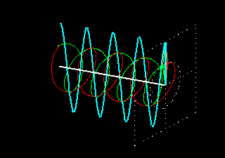
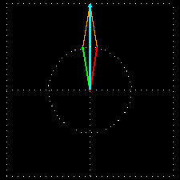
Adding Polarized Light
In phase (peak at the same time) + same amplitude
left circular + right circular = vertical
Green peaks when red peaks.

Slide 21
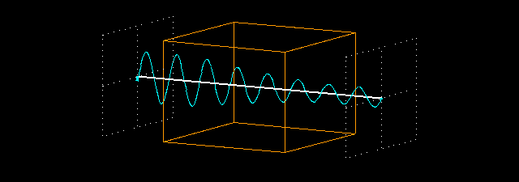
Absorption Spectroscopy
P₀
P
(power in)
(power out)
P
P₀
Absorbance:
A = -log T = log P₀/P

Slide 22
Chiral Molecules

Slide 23
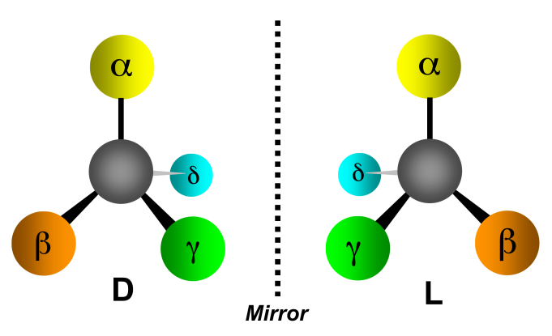
Absorption Spectroscopy
The Beer-Lambert Law:
A = ε c l
ε is the same for D and L
If C are equal:
50:50 D to L
100% D
100% L
Then A is the same.
A = absorbance (unitless, A = log₁₀ P₀/P)
ε = molar absorptivity (L mol⁻¹ cm⁻¹)
l = path length of the sample (cm)
c = concentration (mol/L or M)
Assuming the light is unpolarized!

Slide 24
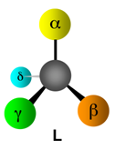
Circular Absorption
Absorbs Less
Larger P
left-circularly polarized
right-circularly polarized
Absorbs more
Smaller P
P₀
P
(power in)
(power out)

Slide 25
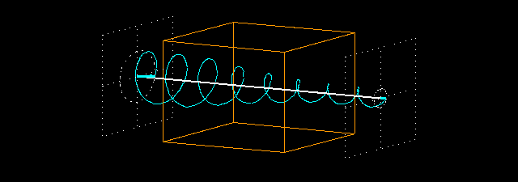
Circular Absorption
P_{(left)}
P_{0(left)}
Absorbance:
A_{(left)} = log P_{0(left)} /P_{(left)}
A_{(right)} = log P_{0(right)}/P_{(right)}
P₀
P
(power in)
(power out)

Slide 26
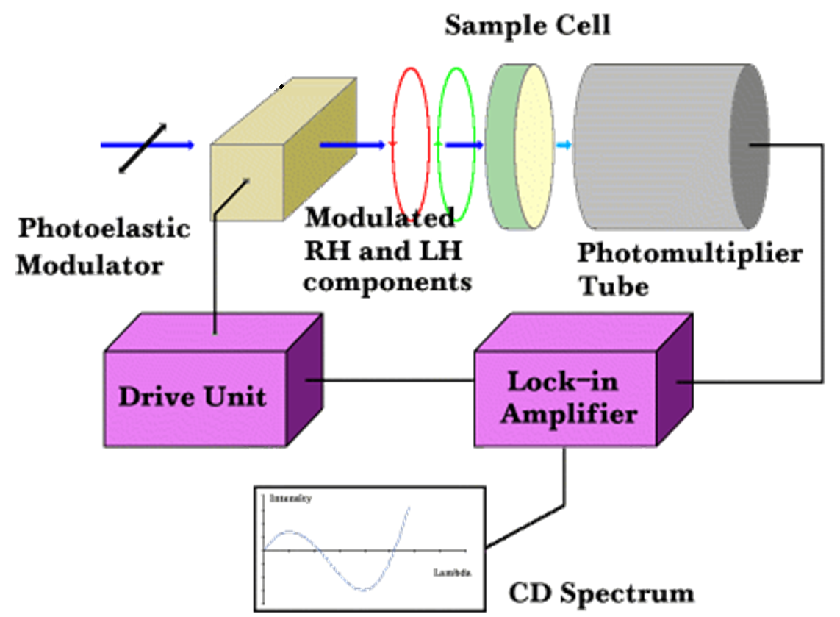
Circular Dichroism
Source
Polarizer
Prism
Process:
1) Unpolarized white light
2) Monochrometer
3) Plane polarizer
4) left-right modulator
5) left (then right) through sample
6) measure P for right (then left) through sample

Slide 27




Circular Dichroism
CD measures the difference between the absorption of left and right handed cirularly-polarized light:
Δε is typically <10 M⁻¹ cm⁻¹
ε is typically > 10,000 cm⁻¹
CD spectra reported in ellipticity (θ) or Δε
θ = 3298 Δε.
ε in L/mol cm (liters mol⁻¹ centimeters⁻¹)
θ in degrees cm²/dmol⁻¹ (degrees centimeters² decimol⁻¹)

Slide 28
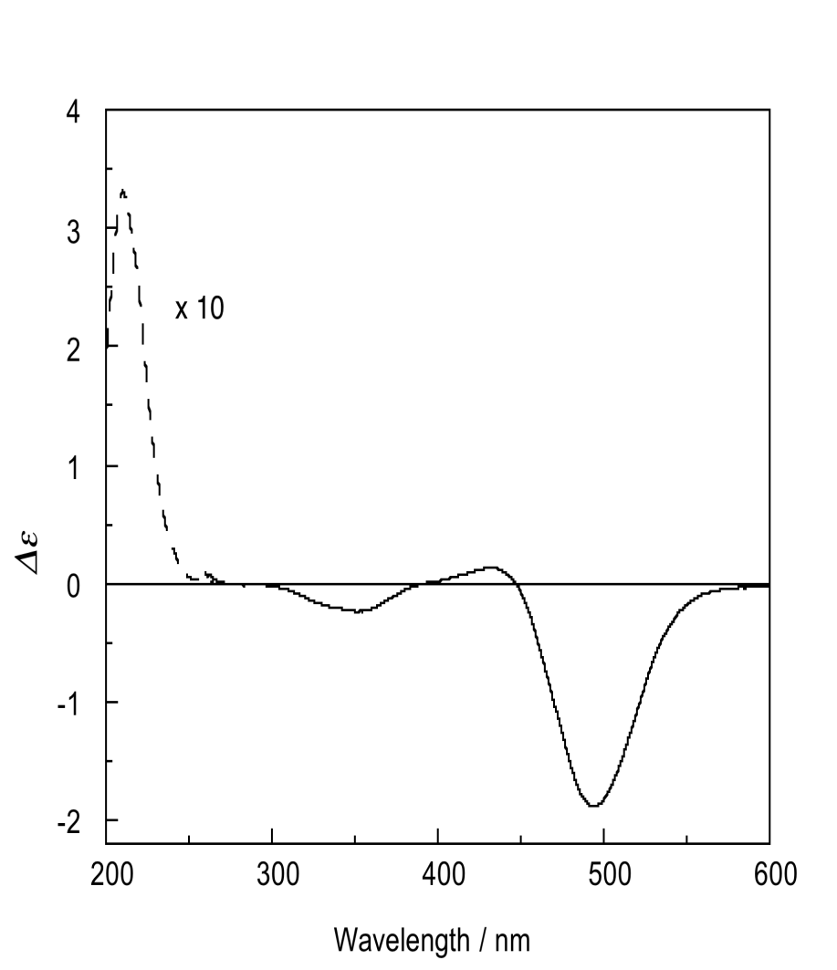
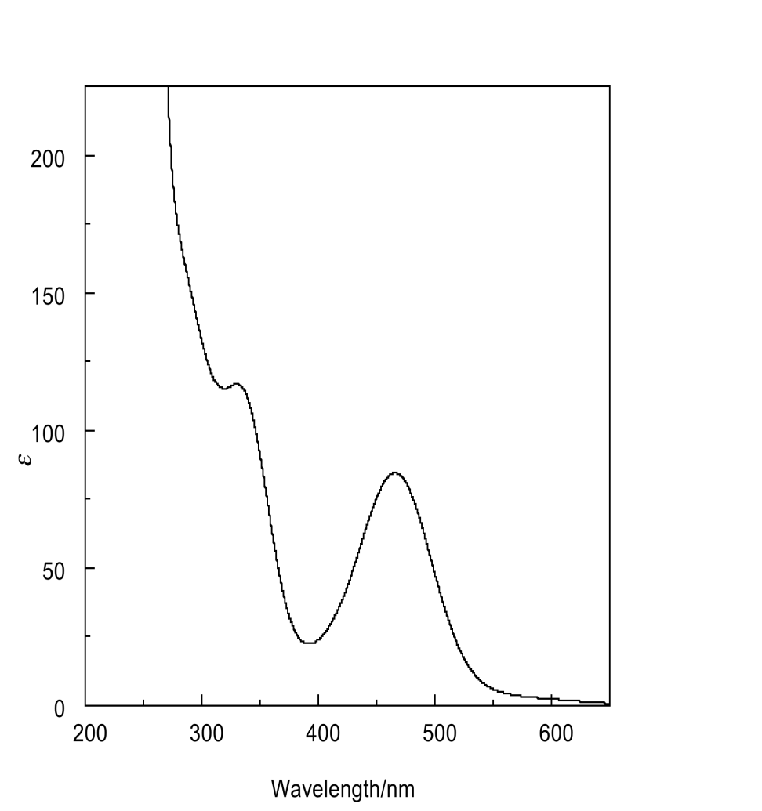
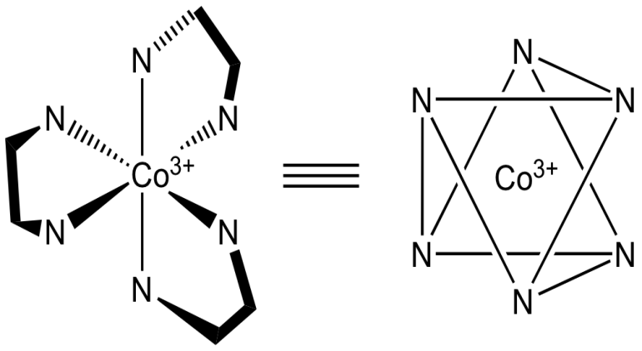
Spectra
Absorption
Circular Dichroism

Slide 29
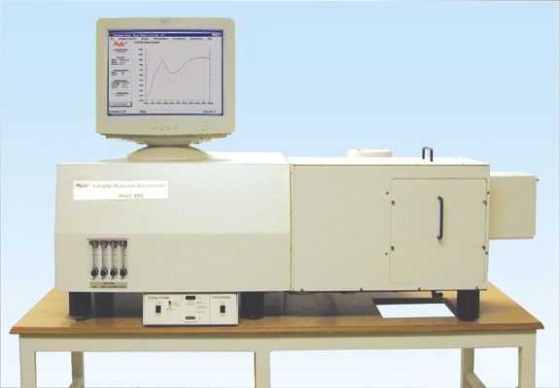
CD Spectrometer
AVIV 202 CD spectrometer
Institute of Molecular Biophysics
170-875 nm
-10ºC to 110ºC
titrator attachment

Slide 30
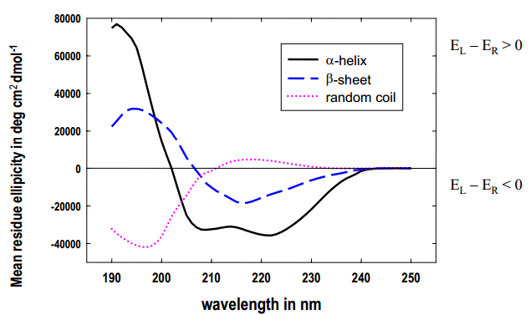
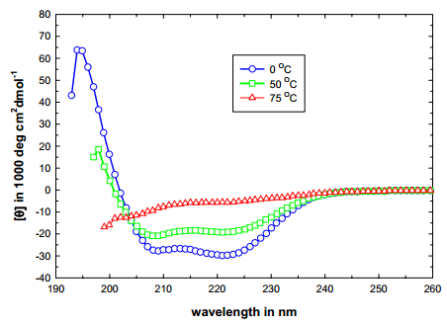
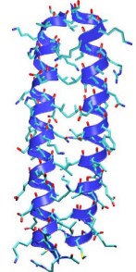
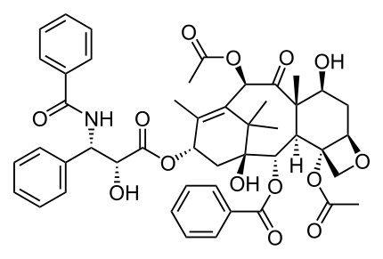
Applications
• Determination of secondary structure of proteins
• Investigations of protein-protein interactions
• Investigation of the effect of drug binding
• Protein structure in a membrane
• Stereoselective synthesis
• Dynamic processes
- protein folding
- reaction dynamics
• DNA denaturation
GCN4-p1 coiled–coil

Slide 31
CD End
Any Questions?

Slide 32
Content
Source
Detector
hν
Sample
1) Circular Dichroism
2) Infrared Spectroscopy

Slide 33
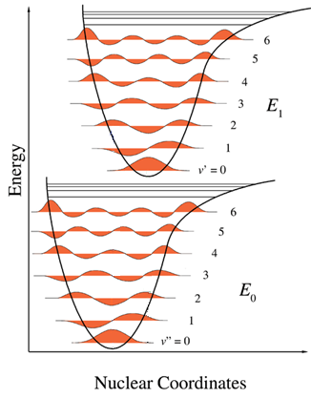

Spectroscopy
Visible: 300-700 nm / 30,000-14,000 cm⁻¹
Mid-IR: 2,500-15,000 nm / 4,000-650 cm⁻¹
Mojet et al. Chem. Soc. Rev. 2010, ASAP.

Slide 34


Infrared Spectroscopy

Slide 35


Infrared Spectroscopy
C_{2v}: 20A₁ + 19B₂ + 9B₁
Kincaid et al. J . Phys. Chem. 1988, 92, 5628.

Slide 36


Applications
Identification of inorganic compounds and organic compounds
Identification of components of an unknown mixture
Analysis of solids, liquids, and gasses
Component quantification
In measurement and analysis of Atmospheric Spectra
Can also be used on satellites to probe space

Slide 37


Infrared Spectroscopy
IR Source
Detector
hν
?
Sample
Procedure
Step 1: Prepare a sample
Step 2: ???
Step 3: Obtain spectra (Profit!)

Slide 38




Infrared Spectroscopy
Discovered:
Uranus
Infrared light
(1800)
Friedrich Wilhelm Herschel
Astronomer
Infrared
H₂O
Sun
Thermometers

Slide 39
Infrared Spectroscopy
IR Source
Detector
hν
?
Sample
Infrared Spectroscopic Techniques
Direct Transmission
Reflection Absorption (RAIRS or IRRAS)
Polarization-Modulated RAIRS
Diffuse Reflectance
Photoacoustic
Attenuated Total Reflectance

Slide 40

Direct Transmission
Sources
Detector
Sample
Bruker 80v
Notes:
talk about FT-IR

Slide 41



Direct Transmission
IR Source
Diode Detector
hν
Sample
Pros:
Simple
Standard
Inexpensive
Cons:
In KBr
No solvent
No surfaces
Boring?
KBr Pellet

Slide 42
Direct Transmission
IR Source
Diode Detector
hν

Slide 43
Reflection Absorption (RAIRS)
AKA: IRRAS, grazing angle IR
From IR Source
To Detector
Reflective surface
Requirements
Highly Reflective
Metals, glass, semiconductor
Planar
Typically monolayers
Disadvantages
Weak Signal (<2% ΔT)
No solvent
Accessory

Slide 44


Reflection Absorption (RAIRS)
Seagull (Harrick Scientific)
Sample

Slide 45
Polarization Modulation-RAIRS
Reflective surface
S-polarized light phase shifts by 180°
P-polarized light phase shifts by 90°
(at 80° incident angle)

Slide 46
Polarization Modulation-RAIRS
p
p
s
s
Reflective surface
S-polarized (180° shift) is destructive
-does not contain information about the interface
P-polarized (90° shift) is non-destructive
-does contain information about the interface

Slide 47
Polarization Modulation-RAIRS
p
P_{(p)}
s
P_{(s)}
Reflective surface
P_{(p)} = solvent + surface
P_{(s)} = solvent
P_{(p)} - P_{(s)} = surface

Slide 48

Polarization Modulation-RAIRS
5
1
3,4
Incident light is polarized
PEM shifts between S and P
Polarized light hits sample
At the surface:
-S-polarized signal is nullified
-P-polarized signal is enhanced
Light hits the detector
P_{(p)} - P_{(s)} = surface spectrum
2

Slide 49

PM-RAIRS vs RAIRS
RAIRS
PM-RAIRS
IR inactive
IR active
ITO
Glass Slide
Paniagua et al. J. Phys. Chem. C 2008, 112, 7809.

Slide 50
Polarization Modulation-RAIRS
Pros:
Can use solvent
Suggests orientation
Sensitive
Cons:
Expensive (>$200,000)
Requires reflective surface
Planar surface
IR inactive
IR active
ITO
Glass Slide

Slide 51

Diffuse Reflectance (DRIFTS)
Factors for Scatter
-Particle Size
50 μm or less
-Refractive Index
-Depth
>1.5 mm

Slide 52


Diffuse Reflectance (DRIFTS)
Ellipsoidal Reflector
Integrating Sphere
Incident light
Sample
Detector

Slide 53



Diffuse Reflectance (DRIFTS)
Pros:
Can measure scattering samples
Accessory
Inexpensive
Cons:
Need a scattering sample
No solvent
Not as sensitive
Pike EasiDiff
Pike AutoDiff

Slide 54

Infrared Spectroscopy
IR Source
Detector
hν
?
Sample
Infrared Spectroscopic Techniques
Direct Transmission
Reflection Absorption (RAIRS or IRRAS)
Polarization-Modulated RAIRS
Diffuse Reflectance
Photoacoustic
Attenuated Total Reflectance

Slide 55

2013 Nobel Peace Prize
The Organisation for the Prohibition of Chemical Weapons (OPCW) is an intergovernmental organisation, located in The Hague, Netherlands. The organisation promotes and verifies the adherence to the Chemical Weapons Convention which prohibits of the use of chemical weapons and requires their destruction. The verification consists both of evaluation of declarations by members states and on-site inspections
“The said interest shall be divided into five equal parts, which shall be apportioned as follows: /- - -/ one part to the person who shall have done the most or the best work for fraternity between nations, the abolition or reduction of standing armies and for the holding and promotion of peace congresses.”
http://www.opcw.org/

Slide 56


Member States
that have signed and ratified or acceded to the Chemical Weapons Convention, an international agreement outlawing the production, stockpiling and use of chemical weapons.

Slide 57



Member States

Slide 58

Members
6 states are non-members:
Angola, Burma, Egypt, Israel, North Korea and South Sudan.
“one part to the person who shall have done the most or the best work for fraternity between nations”

Slide 59


Chemical Warfare
All modern warfare is chemical warfare
Damascus steel
eighth century A.D.
ReiboldM., et al. Nature, 444. 286 (2006)

Slide 60


Chemical Warfare
All modern warfare is chemical warfare
10 KNO₃ + 3 S + 8 C → 2 K₂CO₃ + 3 K₂SO₄ + 6 CO₂ + 5 N₂

Slide 61
Chemical Warfare
Chemical warfare (CW) involves using the toxic properties of chemical substances as weapons. This type of warfare is distinct from nuclear warfare and biological warfare, which together make up NBC, the military acronym for nuclear, biological, and chemical (warfare or weapons), all of which are considered "weapons of mass destruction" (WMD). None of these fall under the term conventional weapons which are primarily effective due to their destructive potential.
Conventional Weapons- small arms and light weapons, sea and land mines, as well as (non-nuclear) bombs, shells, rockets, missiles and cluster munitions.

Slide 62






Chemical Warfare

Slide 63



Chemical Warfare
Harassing Agents
These are substances that are not intended to kill or injure. They are often referred to as Riot Control Agents (RCAs) and may be used by civilian police forces against criminals and rioters, or in the military for training purposes. In general, harassing agents are sensory irritants that have fleeting concentration dependent effects that resolve within minutes after removal. Casualty effects are not anticipated to exceed 24-hours nor require medical attention.

Slide 64

Chemical Warfare
Arguably the highest impact innovations of the twentieth century:
without it, 50% of the world’s population would not be here.
He has also been described as the "father of chemical warfare" for his work developing and deploying chlorine and other poisonous gases during World War I.
Fritz Haber
1868-1934
Nobel in 1918

Slide 65
Chemical Warfare
Gas warfare in World War I was, in a sense, the war of the chemists, with Haber pitted against French Nobel laureate chemist Victor Grignard.
Regarding war and peace, Haber once said, "During peace time a scientist belongs to the World, but during war time he belongs to his country."
This was an example of the ethical dilemmas facing chemists at that time.

Slide 66
Chemical Warfare
Who is making these chemicals?
Who is optimizing their performance?

Slide 67

Research Ethics
If given unlimited resources to work on the biggest engineering, physics and chemistry problem in the history of the world, would you do it?
What if it might be used to vaporize 300,000 humans in an instant?
Manhattan Project
$26 billion
130,000 people

Slide 68




Byproducts
Nuclear Reactors
Large Hadron Colliders
Deuterated Solvents
Isotopic Labeling

Slide 69








Department of Defense
Create a molecules (and an OLED) that efficiently emits between 750 – 900 nm.
Near Infrared OLED Screen
Visible Image
One row of visible pixels
Two rows of n-IR pixels
IR monocular which replaces infrared emission with green

Slide 70


Defense Advanced Research Projects Agency
Create a organic detector array that can monitor between 300-1700 nm.
Readout circuit
Organic photodiode array
anode
organics
cathode
Object
Hemispherical
Focal Plane
Focusing Lens
Ag
Ag
Ag
BCP
C60
Fused Dimer
ITO
Glass

Slide 71
Ethics questions
Would you have worked on the Manhattan Project?
Will you work for the DOD, DARPA, AFOSR…?

Slide 72
Infrared Spectroscopy
IR Source
Detector
hν
?
Sample
Infrared Spectroscopic Techniques
Direct Transmission
Reflection Absorption (RAIRS or IRRAS)
Polarization-Modulated RAIRS
Diffuse Reflectance
Photoacoustic
Attenuated Total Reflectance

Slide 73



Polarization Modulation-RAIRS
p
p
s
s
Reflective surface
S-polarized (180° shift) is destructive
-does not contain information about the interface
P-polarized (90° shift) is non-destructive
-does contain information about the interface
0° shift
90° shift
180° shift
φ = 0
φ = 90°
φ = 180°

Slide 74

Constructive/Destructive Interference

Slide 75

Photoacoustic IR Spectroscopy
IR Light
Carrier Gas
Detector
Incident light
Absorbed by sample
Optical to thermal energy
Heat wave through sample
Thermal-expansion-driven pressurization in the gas
Wave hits the detector
-Microphone
-piezoelectric transducer
Sample
Thermal Wave
Notes:
Alexander Graham Bell in 1880 photoacoustic effect

Slide 76

Photoacoustic IR Spectroscopy
Gratzel et al. J. Phys. Chem. B 2003, 107, 8981.
N712
N719
N3

Slide 77

Photoacoustic IR Spectroscopy
Pros:
Neat Solids
Depth Profiling
Cons:
8 cm⁻¹ resolution
No solvent
Specialty Equipment

Slide 78


Attenuated total reflection (ATR-IR)
Evanescent wave

Slide 79


Attenuated total reflection (ATR-IR)
n₂
n₁
 | n₁ | *d_{p} (μm) | pH Range | LWL, cm⁻¹
AMTIR | 2.5 | 1.46 | 1-9 | 625
Diamond/ZnSe | 2.4 | 1.66 | 1-14 | 525
Diamond/KRS-5 | 2.4 | 1.66 | 1-14 | 250
Germanium | 4 | 0.65 | 1-14 | 780
KRS-5 | 2.37 | 1.73 | 5-8 | 250
Silicon | 3.4 | 0.84 | 1-12 | 1500
Silicon/ZnSe | 3.4 | 0.84 | 1-12 | 525
ZnS | 2.2 | 2.35 | 5-9 | 850
ZnSe | 2.4 | 1.66 | 5-9 | 525
Wavelength
Penetration depth
*d_{p} based on n₂ = 1.5, Θ = 45°, λ = 1000 cm-1
Angle of incidence
Refractive index
crystal (n₁)
sample (n₂)

Slide 80


Attenuated total reflection (ATR-IR)
Single Reflection
Multiple Reflection
Incident light
Detector

Slide 81


Single vs Multi ATR
Pressure
TiO₂
Multi ATR
vs
Pressure
TiO₂
Single ATR

Slide 82


Attenuated total reflection (ATR-IR)
Single Reflection
Multiple Reflection

Slide 83

Attenuated total reflection (ATR-IR)
Gratzel et al. J. Phys. Chem. B 2004, 108, 17553.
Z-955
PO₃H₂
SCN
Glass Slide
Glass Slide
Diamond
C-9 alkyl chain- 2856, 2926, 2959 cm⁻¹
Bipyridine- 1398, 1548, 1615 cm⁻¹
PO₃H₂- 952, 1060, 1151 cm⁻¹
SCN- 2104 cm⁻¹
Source
Detector
Single Reflection

Slide 84


Attenuated total reflection (ATR-IR)
sym SO₃
asym SO₃
Concentration
ZnSe Crystal (50 x 10 x 2 mm)
Coat with TiO₂
Molecule + Water (pH 3.5/HCl)
Monitor adsorption vs concentration
Rivera et al. Langmuir 2010, 26, 5534.

Slide 85

Attenuated total reflection (ATR-IR)
Pros:
Solids/powders/solutions
Solid-solution interface
External stimuli
No prep time
Accessory
Monitor kinetics
Cons:
Pressure sensitive
Less resolution
Crystals are expensive

Slide 86
Infrared Spectroscopy
IR Source
Detector
hν
?
Sample
Infrared Spectroscopic Techniques
Direct Transmission
Reflection Absorption (RAIRS or IRRAS)
Polarization-Modulated RAIRS
Diffuse Reflectance
Photoacoustic
Attenuated Total Reflectance

Slide 87
ATR-IR End
Any Questions?

